Slide 1
Team 2 - Natural Language Processing of Tweets
Presented by:
Thomas D. Robertson II
Tania Perdomo-Flores
Sharon Colson
Caleb Smith
Notes:
Introduce team and mention Tania last:
“and Tania is joining us remotely”

Slide 2
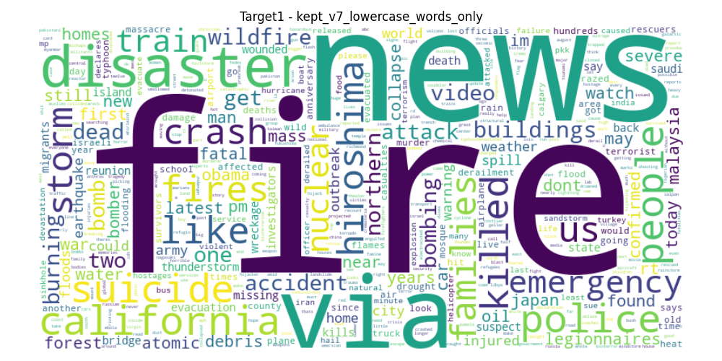
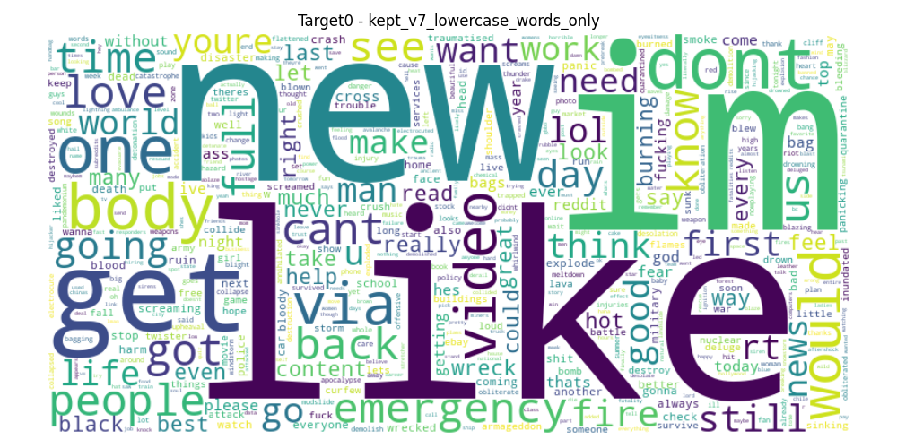
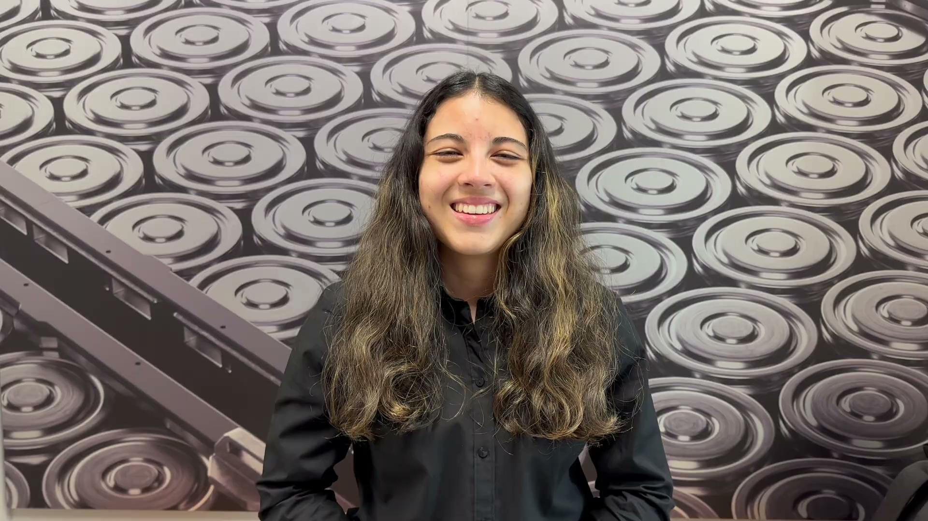
Problem Statement
Motivation:
Twitter and other social media platforms have become essential for modern day real-time communications and information sharing.
These platforms essentially serve as repositories of information to be parsed through..
Not all tweets are disaster related, even if the language in them syntactically matches one. How can we know for sure which ones are relevant or not?
Significance:
A natural Language Processing system designed around parsing through these types of systems could allow for more efficient emergency and disaster response.
Project Goals:
Develop a binary classification model to predict whether a tweet is disaster related or not.
Focus on accuracy, and F1 score to optimize performance of correct classifications.
Model needs to be accurate at classifications, efficient regarding computational demands, and adaptable for scalability needs.
Notes:
TANIA(48sec)
hi , everyone. Today, we will be walking you through a project that tackles a growing challenge in our hyper-connected world: identifying disaster-related content on Twitter in real time—using Natural Language Processing.
Let’s be real—Twitter and other platforms are a double-edged sword. They're essential for real-time information sharing, especially during emergencies, but they're also flooded with irrelevant chatter. Just because a tweet sounds like it’s about a disaster doesn’t mean it is. Our question is simple: Can we teach machines to tell the difference?
We set out to build a binary classification model— as either disaster or non-disaster. Our focus was on three things:
Accuracy – because wrong predictions are worse than no predictions.
F1 Score – to balance precision and recall.
Efficiency and Scalability – because a good model that takes five minutes per tweet isn’t actually good.
(NEXT SLIDE)

Slide 3
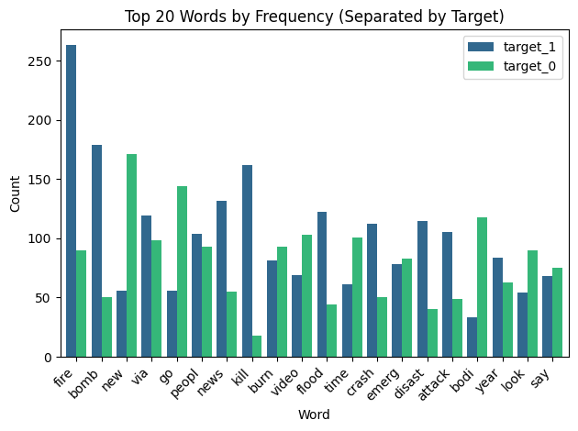
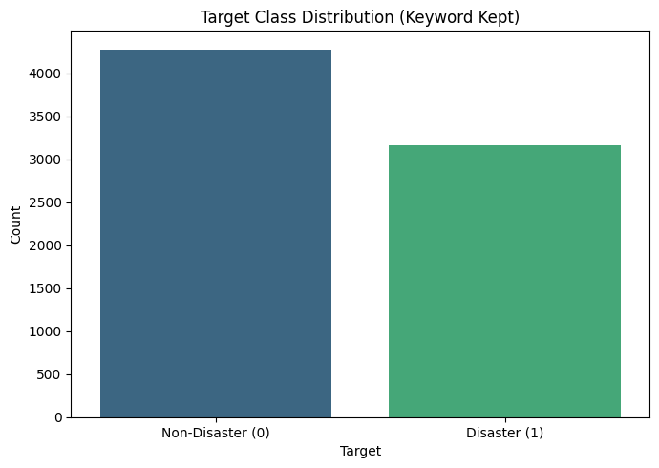
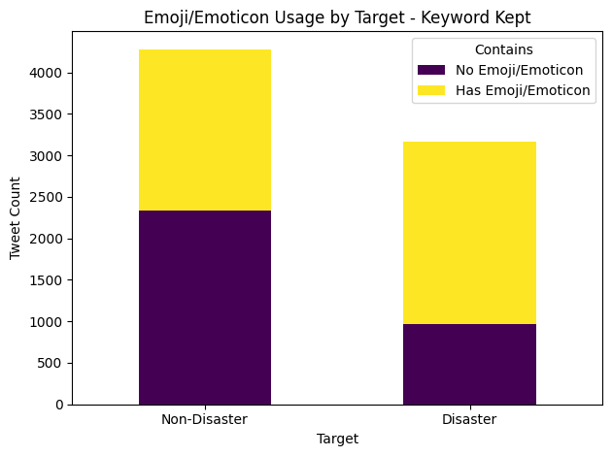
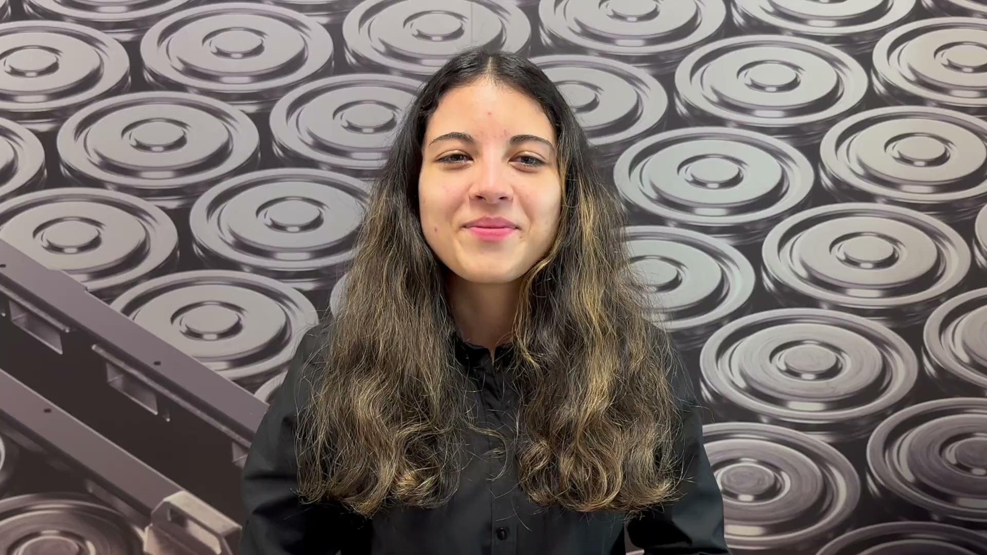
Dataset Overview
Source: Kaggle dataset - Natural Language Processing with Disaster Tweets
Tweets: Tweets are classified as either 0 (non-disaster) or 1 (disaster) related, signifying which classification type it belongs to.
Variables: ID (identifier), text, location, keyword (highlighted word), target (classification)
Notes:
TANIA(22sec)
We used dataset from Kaggle called “Natural Language Processing with Disaster Tweets.” Each tweet comes with:
An ID
The text of the tweet
An optional location and keyword
And most importantly: a target variable—either 0 for non-disaster or 1 for disaster.
This clean, labeled data is our training ground for building a model that learns the patterns behind disaster-related language.
(NEXT SLIDE)

Slide 4
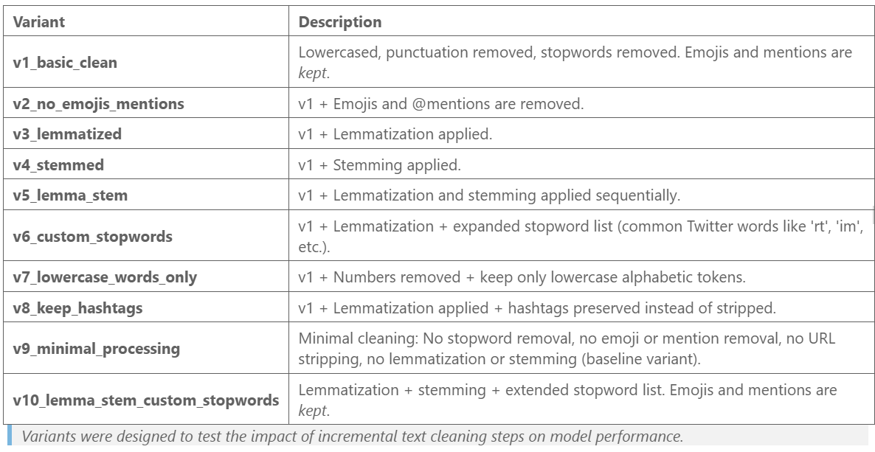
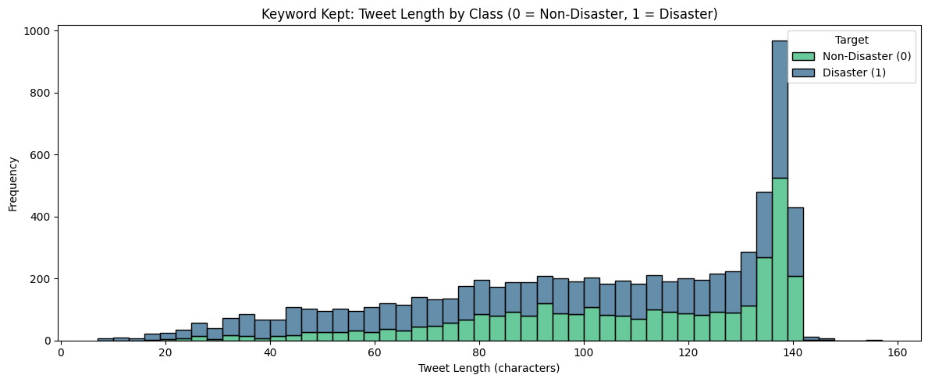
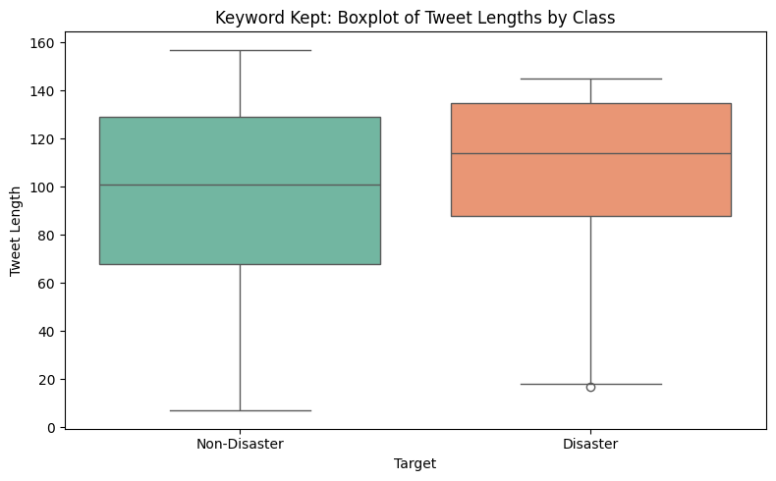
Data Preparation and Cleaning
Handling The Datasets:
3 Variants of the original dataset processed in 10 ways
Outliers: Evaluated primarily on Tweet length. Left skewed dataset. No extreme length Tweets detected. Short Tweets were kept.
Tools Used: WordNetLemmatizer, PorterStemmer, TweetTokenizer from NLTK
Notes:
Sharon

Slide 5
Methods Explored
Data Cleaning:
Correction of corrupted character sequences.
Dropping of columns deemed irrelevant for analysis and modeling.
Removal of duplicate tweets and noise (same tweets with different labels)
Modeling:
Various machine learning models were utilized, including Naive Bayes, Logistic Regression, Passive Aggressive Classifier, Support Vector Machine, K-Nearest Neighbors, and Multi-Layer Perceptron.
Additionally, two pre-trained models were fine-tuned for this classification task: BERT-Base-Uncased and BERTweet-Base.
Models were run on vectorized representations of text data.
Model Evaluation:
Accuracy: The overall percentage of correct classifications across all predictions.
Precision: The proportion of predicted disaster tweets that were correctly classified as disaster-related.
Sensitivity (Recall): The ability of the model to correctly identify all disaster-related tweets.
F1 Score: The harmonic mean of precision and recall, providing a balanced measure of the model's performance.
AUC/ROC: A visual and quantitative assessment of the model’s ability to distinguish between the positive and negative classes.
Notes:
Sharon?

Slide 6
BERT Explained
BERT (Bidirectional Encoder Representations from Transformers) is a pre-trained model designed to capture contextual meaning from both directions in a sentence.
Purpose: Enables machine application to understand nuanced meaning in natural language text.
Approach: Fine-tuned BERT models for downstream tasks such as disaster tweet classification.
Models Used:
BERT-Base-Uncased: General-purpose English text model.
BERTweet-Base: Specialized model pre-trained on raw tweet data.
Performance Expectation: BERTweet-Base expected to outperform due to training on tweet-specific language patterns.
Resource Considerations: Despite pre-training, fine-tuning BERT models requires significant computational resources.
Tradeoff: Gains in model performance must be weighed against the substantially higher resource demands.
Notes:
Caleb

Slide 7
Tools - Data Cleaning, Visualization, Model Evaluation
Python - The primary language used to process the dataset
Pandas (Data Cleaning): - Used for general data manipulation and cleaning tasks.
NLTK (NLP): Used for text tokenization, stemming, and tagging for tweet analysis.
Matplotlib, Seaborn, Word Cloud (Visualization):
Scikit-learn (Modeling): Model implementation, performance evaluation, and utility functions such as cross validation.
GirdSearchCV (Hypertuning) - Automated hyperparameter optimizations within model pipeline.
Hugging Face Transformers - Implements the BERT-Base-Uncased and BERTweet-Base pre-trained modules.
Notes:
Caleb?

Slide 8
Project Results
Best Overall Model: Passive Aggressive Classifier
Linear classifier model that updates weights as it makes mistakes.
This model performed the best on the most datasets relative to other models.
Best overall model for results vs computational demands in comparison to BERT and Neural Networks.
The only trained model that achieved above the target F1 score of 75%
Pre-Trained Model Analysis: BERT and BERTweet
BERT-Base-Uncased:
Achieved 83.14% Accuracy and 79.64% F1 Score.
Strong balance between Precision (81.83%) and Recall (77.57%).
Demonstrated effective disaster tweet classification, minimizing false positives.
BERTweet-Base:
Achieved the best results: 84.08% Accuracy and 80.81% F1 Score.
Precision (82.89%) and Recall (78.83%) were consistently higher than BERT-Base.
Better understanding of Twitter-specific language (hashtags, slang, emojis).
Key Insights:
BERTweet outperformed BERT-Base across all metrics.
Both BERT models slightly outperformed traditional classifiers, but not dramatically..
Computational Cost Tradeoff:
BERT models require substantially more computing resources.
Gains in performance may not always justify the higher cost for real-time systems.
Notes:
THOMAS - Needs finished
Most Interpretable Model: Decision Tree
Balanced accuracy: 72.66%, with high interpretability.
Balanced accuracy, good for presenting determinants of predictions.
Useful for clinical setting discussions of onset causes.

Slide 9
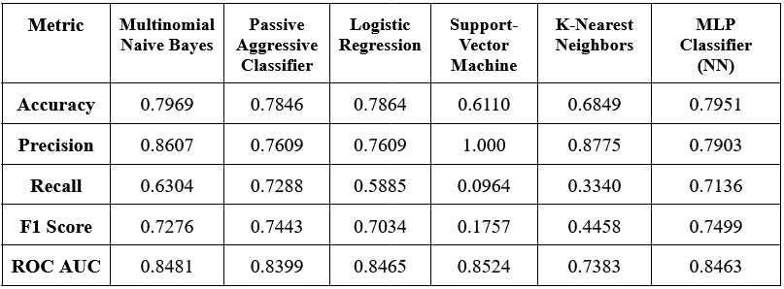
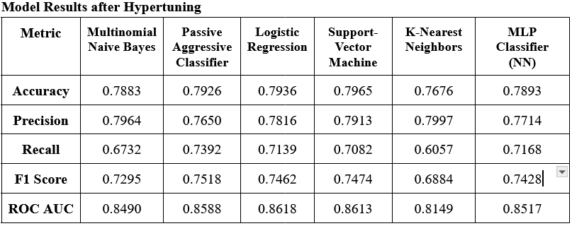
Model Results before and after Hypertuning
Before:
Key Takeaways:
SVM showed the most dramatic benefit, unsurprising as they were the most imbalance to begin with.
KNN moved from poor to usable after hypertuning, but still trails the best models at classification predictions.
Models that were already balanced received the least benefit from hypertuning
After:
Notes:
THOMAS
Most Interpretable Model: Decision Tree
Balanced accuracy: 72.66%, with high interpretability.
Balanced accuracy, good for presenting determinants of predictions.
Useful for clinical setting discussions of onset causes.

Slide 10
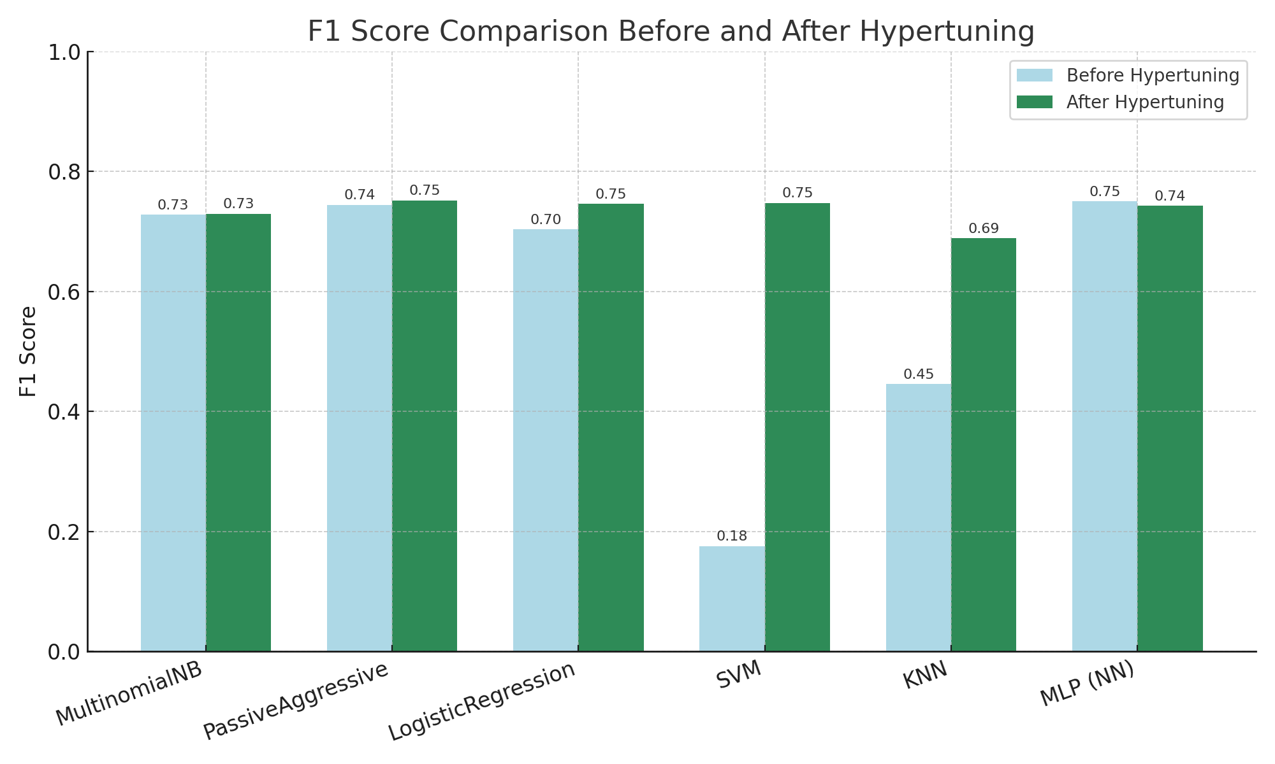
Initial F1 Score Improvement - Visualized
Notes:
THOMAS
Most Interpretable Model: Decision Tree
Balanced accuracy: 72.66%, with high interpretability.
Balanced accuracy, good for presenting determinants of predictions.
Useful for clinical setting discussions of onset causes.

Slide 11
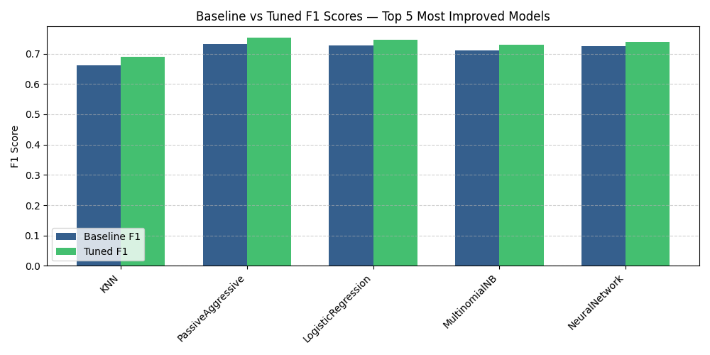
Tuned F1 Score Improvement - Visualized
Notes:
THOMAS
Most Interpretable Model: Decision Tree
Balanced accuracy: 72.66%, with high interpretability.
Balanced accuracy, good for presenting determinants of predictions.
Useful for clinical setting discussions of onset causes.

Slide 12
Challenges
The datasets required extensive pre-processing methods to account for all of the unnecessary or corrupted characters.
Multiple iterations of data cleaning were necessary to test various dataset variations and measure their impact on model performance.
As the size and number of dataset variations increased, computational demands grew significantly. Heavy models (especially neural networks and SVM) required the use of an HPC cluster, with some runs taking up to 16 hours.
Running datasets in parallel on the HPC saved several days of runtime but introduced additional challenges:
No live output to screen during runs, making real-time monitoring impossible.
Some critical evaluation results were missed and required re-running experiments.
Final metrics from multiple runs had to be carefully gathered, organized, and married together for complete evaluation.
The performance vs computational tradeoff of training the data made certain models difficult to gather results for, particularly with the Neural Networks and Support Vector Machine.
Notes:
Sharon

Slide 13
Summary
Most reliable model: Passive Aggressive Classifier
Suitable for real-world use and streaming.
Very computationally efficient relative to results.
Lessons Learned:
Neural Networks require significantly more computing power than is realistic for this classification scenario, would need more optimization for the time required to offset the computation requirements for a real-time streaming environment that needs to continuously update.
Simple models with hypertuning on a properly trimmed dataset achieve comparable performance to larger more computationally demanding models such as Bert Tweet.
The best model depends on the specific needs of the application.
Future work could explore:
Further parameter optimization or ensemble techniques to improve performance.
Creating an application for first responders that would send information alerts (similar to an amber alert) whenever detected disaster related tweets exceeds a certain threshold. To serve as an early warning system.
Notes:
Thomas

Slide 14
Executive Summary
Natural Language Processing of Tweets
Objective:
Develop predictive models to classify tweets as disaster related or not.
Key Results:
Simple models with hypertuning on a properly trimmed dataset achieve comparable performance to larger more computationally demanding models such as Bert Tweet.
Passive Aggressive Classifiers online training methods achieved the best results of the trained datasets, showcasing its ability to adapt to real-time data streams and highlighting its application potentials.
Recommendations:
Model choice should depend on current goal and available resources. Simple models for real-time streaming, otherwise Neural Networks (Like BERT).
Future works:
Creating an application for first responders that would send information alerts (similar to an amber alert) whenever detected disaster related tweets exceeds a certain threshold. To serve as an early warning system.
Notes:
Swap to this slide when taking questions: Caleb + Thomas

Slide 15
Model Information Simplified - Questions
Multinomial Naive Bayes (MNB)
Treats words like clues for classification. If disaster words ("earthquake", "fire") are present, predicts disaster.
Uses probabilities based on word frequency.
Logistic Regression
Treats each word like a vote toward disaster or not.
Strong words (e.g., "explosion") weigh more heavily.
Adds votes and picks the best label.
Passive Aggressive Classifier (Linear Model - Similar to logistic regression)
Learns on the fly — adjusts weights only when it makes a mistake, using gradient descent.
Passive when right, aggressive when wrong.
Great for real-time streams like live tweets.
Support Vector Machine (SVM)
Draws a boundary between disaster and non-disaster tweets.
Tries to maximize the margin between the two groups.
Strong at cleanly separating classes.
Notes:
Only use this for answering

Slide 16
Model Information Simplified - Questions
K-Nearest Neighbors (KNN)
Classifies based on proximity to labeled examples.
Simple, non-parametric approach but computationally intensive for large datasets.
Performance depends heavily on dataset size and noise.
Multi-Layer Perceptron (MLP) Classifier
Feedforward neural network with a hidden layer of 50 neurons.
Uses ReLU activation and Adam optimizer for non-linear learning.
Captures complex relationships but requires significantly more computational power.
BERT and BERTweet Models
Transformer-based models using bidirectional context for deeper language understanding.
BERT-Base-Uncased: Trained on general English text.
BERTweet-Base: Specialized for raw Tweet data — expected to perform better in this task.
Fine-tuning offers strong results but at the cost of heavy computational requirements.
Notes:
Only use this for answering

Slide 17
THANK YOU!

